Slide 1
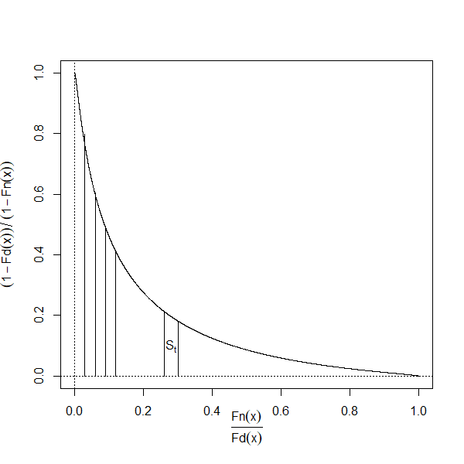
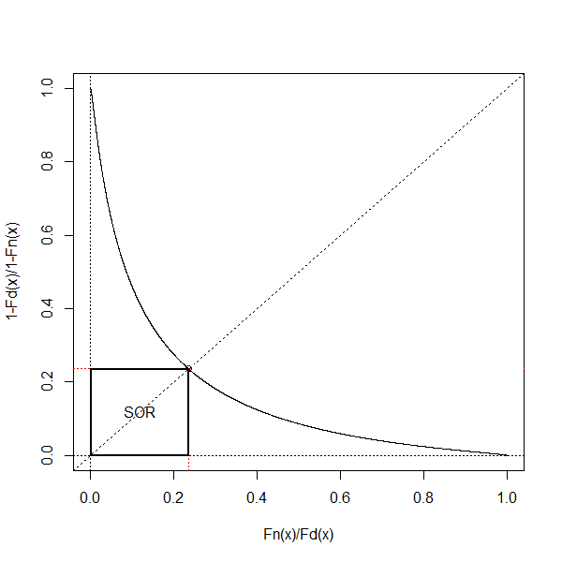
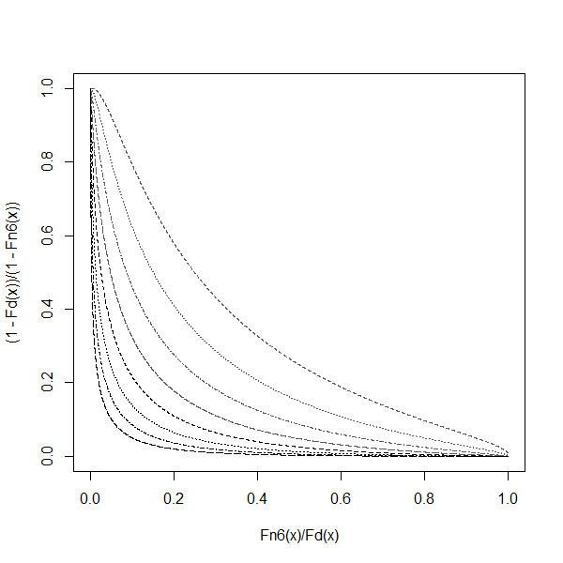
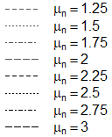
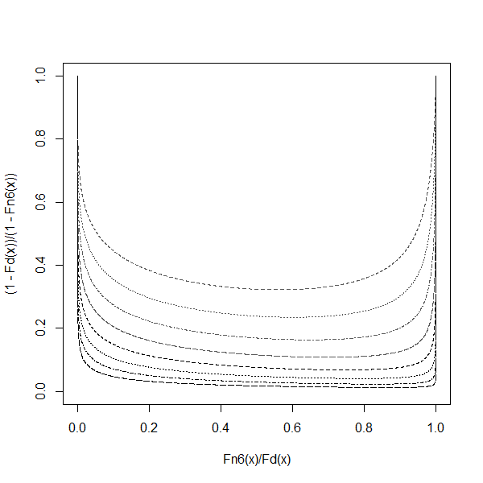
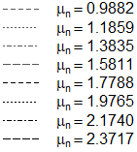
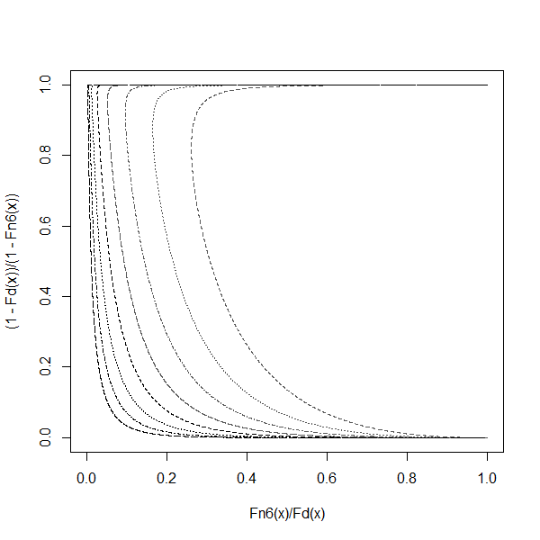
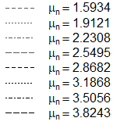
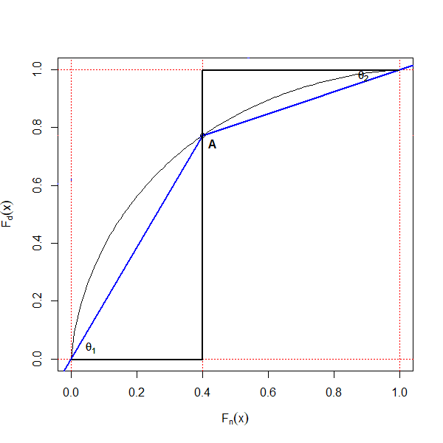
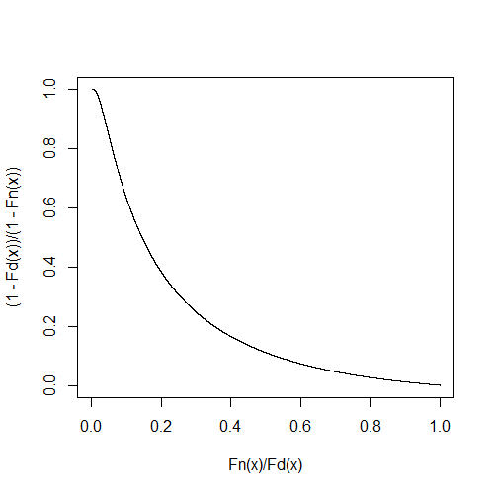
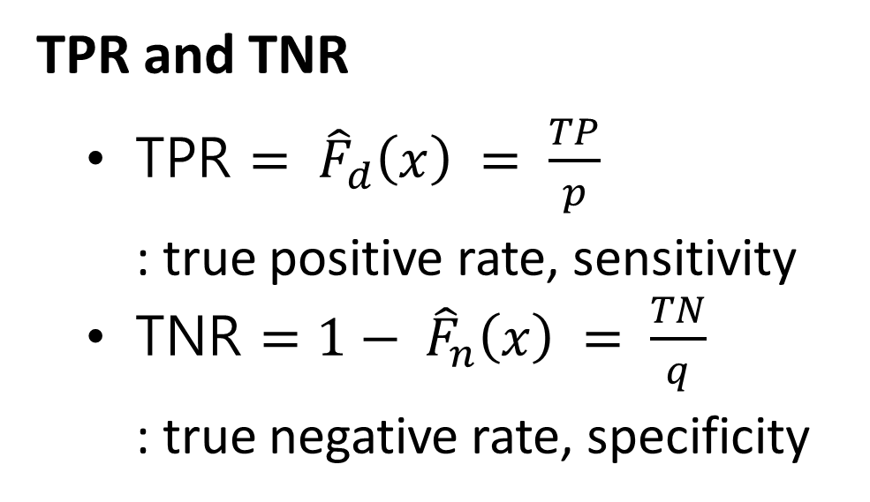
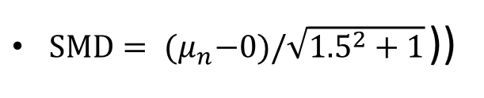
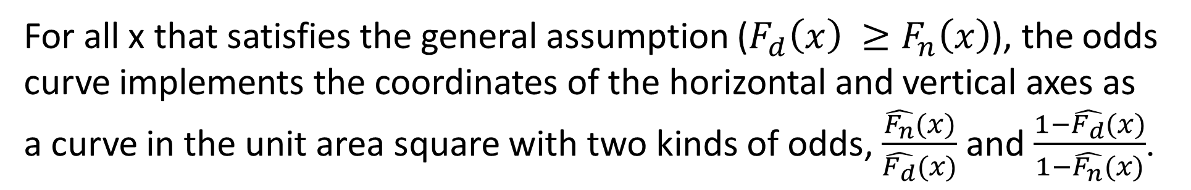

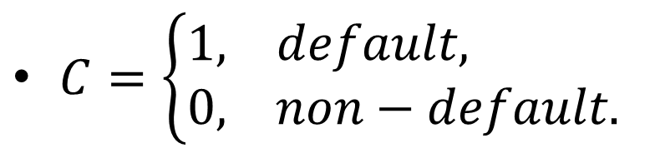
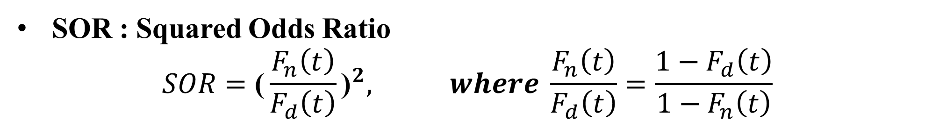
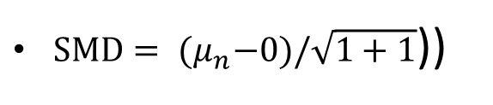
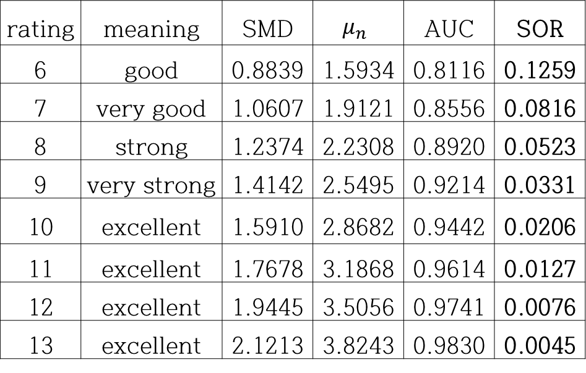
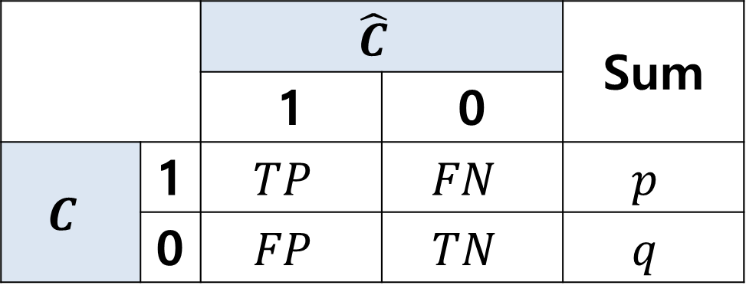
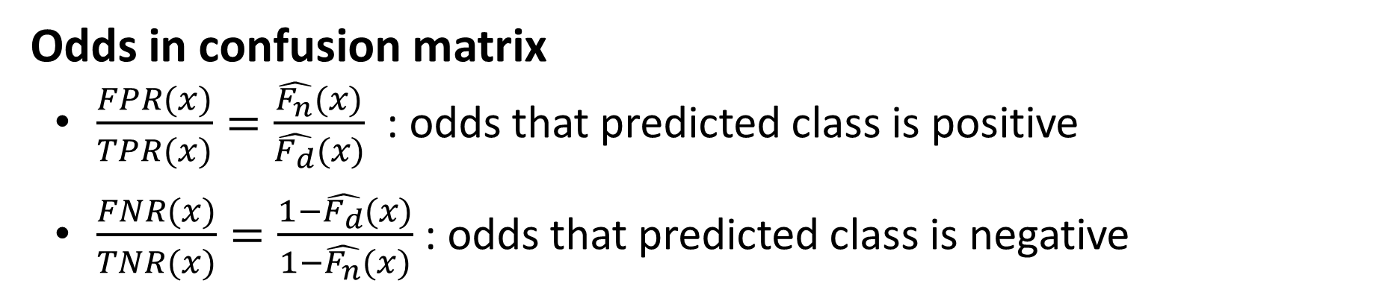

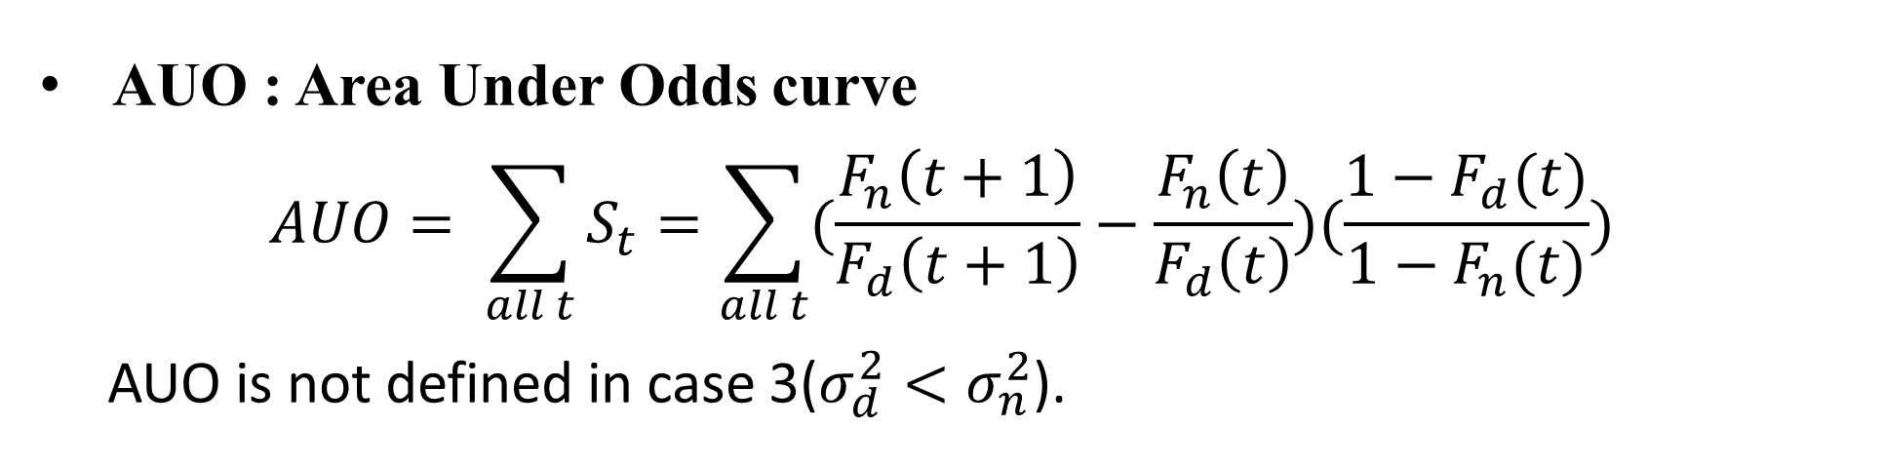
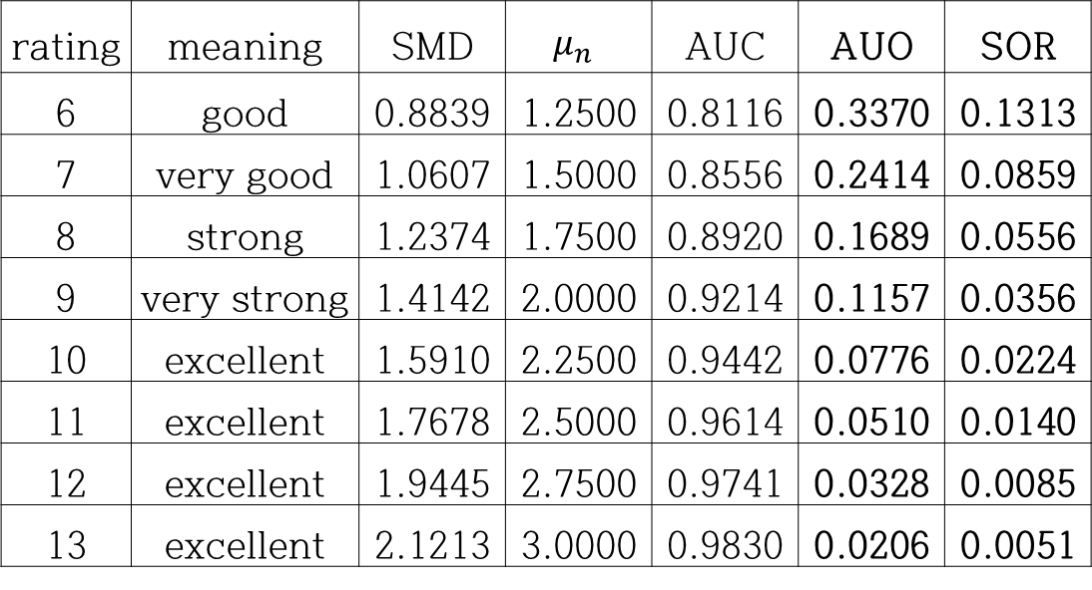
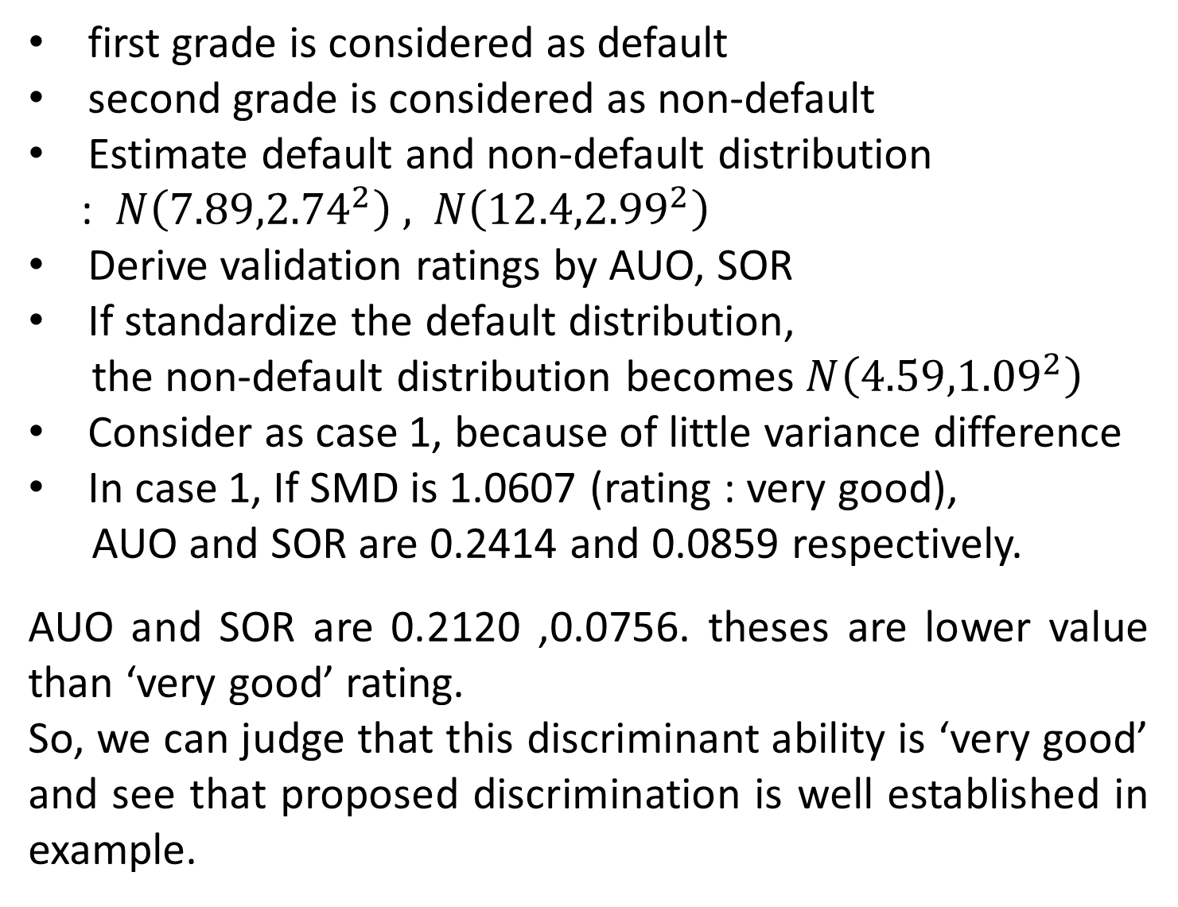
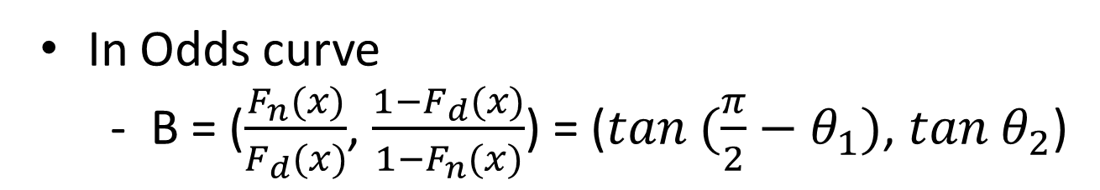
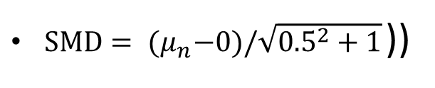

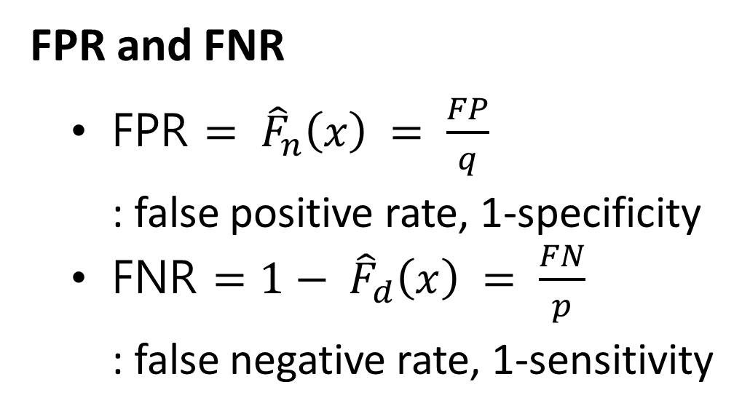
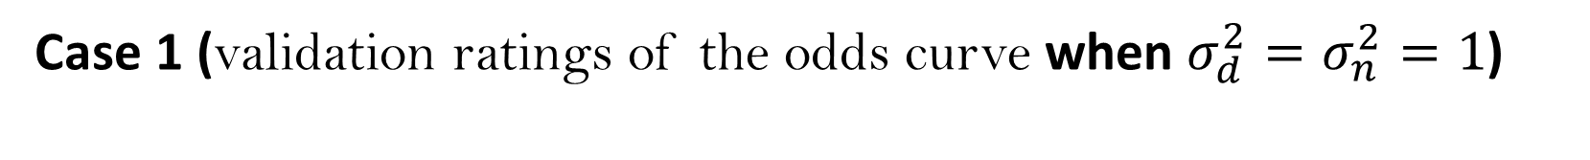
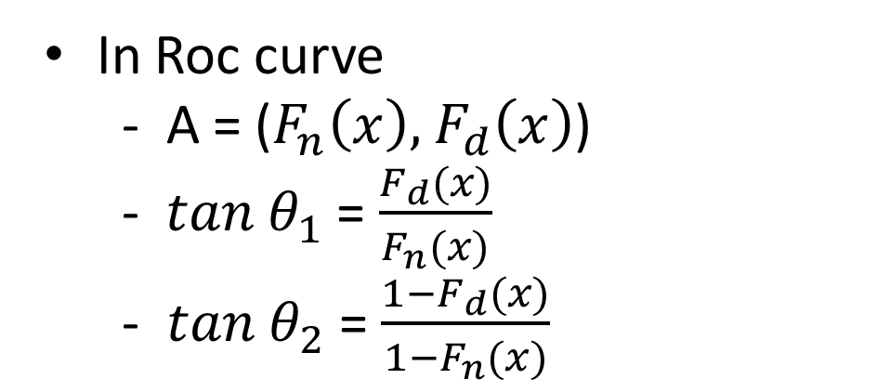
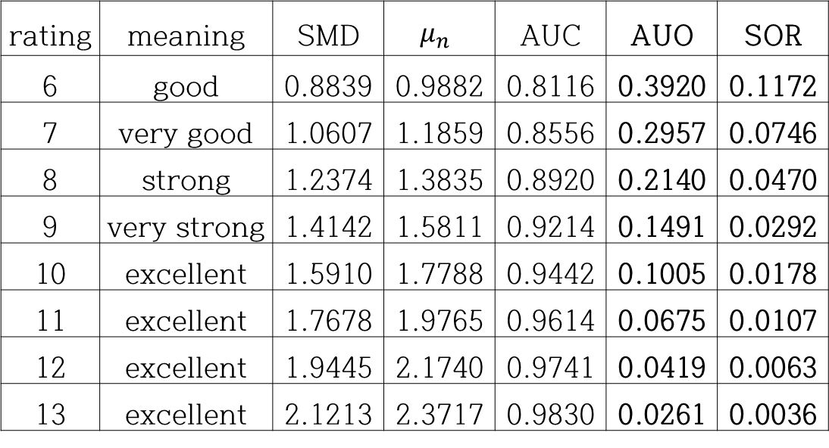
혼동행렬에 대한 오즈 곡선
오세현, 홍종선
성균관대학교 통계학과
Research Procedure
Consider two types odds.
Propose ‘Odds curve’ using these odds.
Explain relationships between odds curve and ROC curve.
Propose two statistics that measure the discriminant power.
Develop validation ratings based on odds curve
Figure 4. AUO for odds curve
Figure 5. SOR for odds curve
Literature Review
Validation ratings in Odds curve
Confusion matrix
Case 1 (validation ratings of the odds curve when $σ_{d}^{2}=σ_{n}^{2}=1$)
 |  | $$\hat{C}$$ |  | Sum
 |  | 1 | 0
$$C$$ | 1 | $$TP$$ | $$FN$$ | $$p$$
 | 0 | $$FP$$ | $$TN$$ | $$q$$
$C=\left\{\begin{aligned}1, default, \\ &0, non−default.\end{aligned}\right.$
rating | meaning | SMD | $$μ_{n}$$ | AUC | AUO | SOR
6 | good | 0.8839 | 1.2500 | 0.8116 | 0.3370 | 0.1313
7 | very good | 1.0607 | 1.5000 | 0.8556 | 0.2414 | 0.0859
8 | strong | 1.2374 | 1.7500 | 0.8920 | 0.1689 | 0.0556
9 | very strong | 1.4142 | 2.0000 | 0.9214 | 0.1157 | 0.0356
10 | excellent | 1.5910 | 2.2500 | 0.9442 | 0.0776 | 0.0224
11 | excellent | 1.7678 | 2.5000 | 0.9614 | 0.0510 | 0.0140
12 | excellent | 1.9445 | 2.7500 | 0.9741 | 0.0328 | 0.0085
13 | excellent | 2.1213 | 3.0000 | 0.9830 | 0.0206 | 0.0051
Table 1. Confusion matrix
$SMD= {(μ}_{n}−0)/\sqrt{1+1}$))
TPR and TNR
TPR $= {\hat{F}}_{d}\left(x\right) = \frac{TP}{p}$
: true positive rate, sensitivity
TNR $=1− {\hat{F}}_{n}\left(x\right) = \frac{TN}{q}$
: true negative rate, specificity
FPR and FNR
FPR $= {\hat{F}}_{n}\left(x\right) = \frac{FP}{q}$
: false positive rate, 1-specificity
FNR $=1− {\hat{F}}_{d}\left(x\right) = \frac{FN}{p}$
: false negative rate, 1-sensitivity
Table 2. Validation ratings in case 1
If the AUO is less than 0.33, it is a ‘good’ situation, and it can be judged that the discriminant power is good. The same is true if the SOR is less than 0.13
Case 2 (validation ratings of the odds curve when $σ_{d}^{2}>σ_{n}^{2}={0.5}^{2}$)
rating | meaning | SMD | $$μ_{n}$$ | AUC | AUO | SOR
6 | good | 0.8839 | 0.9882 | 0.8116 | 0.3920 | 0.1172
7 | very good | 1.0607 | 1.1859 | 0.8556 | 0.2957 | 0.0746
8 | strong | 1.2374 | 1.3835 | 0.8920 | 0.2140 | 0.0470
9 | very strong | 1.4142 | 1.5811 | 0.9214 | 0.1491 | 0.0292
10 | excellent | 1.5910 | 1.7788 | 0.9442 | 0.1005 | 0.0178
11 | excellent | 1.7678 | 1.9765 | 0.9614 | 0.0675 | 0.0107
12 | excellent | 1.9445 | 2.1740 | 0.9741 | 0.0419 | 0.0063
13 | excellent | 2.1213 | 2.3717 | 0.9830 | 0.0261 | 0.0036
Odds in confusion matrix
$\frac{FPR(x)}{TPR(x)}=\frac{\hat{F_{n}}(x)}{\hat{F_{d}}(x)}$ : odds that predicted class is positive
$\frac{FNR(x)}{TNR(x)}=\frac{1−\hat{F_{d}}(x)}{1−\hat{F_{n}}(x)}$ : odds that predicted class is negative
Odds curve
Table 3. Validation ratings in case 2
$SMD= {(μ}_{n}−0)/\sqrt{{0.5}^{2}+1}$))
If the AUO is less than 0.39, it is a ‘good’ situation, and it can be judged that the discriminant power is good. The same is true if the SOR is less than 0.11
For all x that satisfies the general assumption ($F_{d}\left(x\right) ≥F_{n}\left(x\right)$), the odds curve implements the coordinates of the horizontal and vertical axes as a curve in the unit area square with two kinds of odds, $\frac{\hat{F_{n}}(x)}{\hat{F_{d}}(x)}$ and $\frac{1−\hat{F_{d}}(x)}{1−\hat{F_{n}}(x)}$.
Case 3 (validation ratings of the odds curve when $σ_{d}^{2}<σ_{n}^{2}={1.5}^{2}$)
rating | meaning | SMD | $$μ_{n}$$ | AUC | SOR
6 | good | 0.8839 | 1.5934 | 0.8116 | 0.1259
7 | very good | 1.0607 | 1.9121 | 0.8556 | 0.0816
8 | strong | 1.2374 | 2.2308 | 0.8920 | 0.0523
9 | very strong | 1.4142 | 2.5495 | 0.9214 | 0.0331
10 | excellent | 1.5910 | 2.8682 | 0.9442 | 0.0206
11 | excellent | 1.7678 | 3.1868 | 0.9614 | 0.0127
12 | excellent | 1.9445 | 3.5056 | 0.9741 | 0.0076
13 | excellent | 2.1213 | 3.8243 | 0.9830 | 0.0045
Table 4. Validation ratings in case 3
$SMD= {(μ}_{n}−0)/\sqrt{{1.5}^{2}+1}$))
(1) $σ_{d}^{2}=σ_{n}^{2}$
(2) $σ_{d}^{2}>σ_{n}^{2}$
(3) $σ_{d}^{2}<σ_{n}^{2}$
If the SOR is less than 0.12, it is a ‘good’ situation, and it can be judged that the discriminant power is good.
Figure1 : Odds curve
Empirical example
Case (1) ‘J’ shape Case (2) ‘U’ shape Case (3) ‘C’ shape
RS grade | 1 | 2 | 3 | 4 | 5 | 6 | 7 | 8 | 9 | 10
default | 745 | 1424 | 1837 | 2514 | 38060 | 5893 | 7676 | 8985 | 9455 | 5676
non-default | 0 | 0 | 0 | 55 | 56 | 175 | 189 | 279 | 518 | 421
Relationships between odds curve and Roc curve
In Roc curve
- A = ($F_{n}\left(x\right)\text{, }F_{d}\left(x\right)$)
- $tan{ θ}_{1}$= $\frac{F_{d}(x)}{F_{n}(x)}$
- $tan{ θ}_{2}$ = $\frac{{1−F}_{d}(x)}{{1−F}_{n}(x)}$
In Odds curve
- B = ($\frac{F_{n}(x)}{F_{d}(x)}$, $\frac{{1−F}_{d}(x)}{{1−F}_{n}(x)}$) = ($tan{ (\frac{π}{2}−θ}_{1})$, $tan{ θ}_{2}$)
RS grade | 11 | 12 | 13 | 14 | 15 | 16 | 17 | 18 | 19 | 20 | Total
default | 3759 | 2854 | 1546 | 1078 | 5 | 16 | 12 | 0 | 0 | 0 | 57335
non-default | 875 | 761 | 631 | 1102 | 555 | 965 | 347 | 0 | 0 | 0 | 6929
Table 5. RS ratings data of K bank
first grade is considered as default
second grade is considered as non-default
Estimate default and non-default distribution
: $N\left({7.89,2.74}^{2}\right) ,$ $N\left({12.4,2.99}^{2}\right)$
Derive validation ratings by AUO, SOR
If standardize the default distribution,
the non-default distribution becomes $N\left({4.59,1.09}^{2}\right)$
Consider as case 1, because of little variance difference
In case 1, If SMD is 1.0607 (rating : very good),
AUO and SOR are 0.2414 and 0.0859 respectively.
AUO and SOR are 0.2120 ,0.0756. theses are lower value than ‘very good’ rating.
So, we can judge that this discriminant ability is ‘very good’ and see that proposed discrimination is well established in example.
B
Figure 6. Odds curve in example
Figure 2. Roc curve
Figure 3. Odds curve
SMD | 1.1120
AUO | 0.2120
SOR | 0.0756
Two statistics for discriminant power
AUO : Area Under Odds curve
$$AUO= \sum_{all t}{S_{t}=\sum_{all t}{(\frac{F_{n}\left(t+1\right)}{F_{d}\left(t+1\right)}−\frac{F_{n}\left(t\right)}{F_{d}\left(t\right)})(\frac{{1−F}_{d}(t)}{{1−F}_{n}(t)})}}$$
AUO is not defined in case 3($σ_{d}^{2}<σ_{n}^{2}$).
Table 6. Validation in example
Conclusions
SOR : Squared Odds Ratio
$$SOR={\text{(}\frac{F_{n}\left(t\right)}{F_{d}\left(t\right)}\text{)}}^{2}, where \frac{F_{n}\left(t\right)}{F_{d}\left(t\right)}=\frac{{1−F}_{d}\left(t\right)}{{1−F}_{n}\left(t\right)}$$
Two classifications can be predicted and estimated based on the shape of various odds curves, and two types of discriminant are measured
We can judge validation ratings for 13 level using AUO, SOR
Odds curve measures the classification performance of the two distributions, such as ROC, TOC curves

